Slide 1
Methods 3: Multilevel Statistical Modeling and Machine Learning
Class 01:
Setting up R and Python and recollection of the general linear model
September 6, 2024

Slide 2
Why are we not on UCloud?

Slide 3
Going local
Pros
  It is valuable to be able to run things locally
  We do not suffer from the outages of UCloud
  You will acquire knowledge on how to set up environments
  You will acquire knowledge on how to use GitHub
Cons
  You may suffer from local set-up issues
  You may encounter problems with big datasets (we are not using any here)
  It would be valuable to learn more about running in a cloud system

Slide 4
Feedback policy – reminder
  Detailed written feedback will be provided for Assignment 1 only, with the aim of aligning expectations of the instructor and students regarding how assignments will generally be read and graded. This has to be handed in as a study group assignment – otherwise you do NOT get feedback. Oral feedback will be provided on subsequent portfolio assignments during in-class assignment preparation sessions, where students will have ample opportunity to ask the instructor questions on their assignments-in-progress.

Slide 5
Academic regulations
It must be possible to carry out an individual assessment. So if some parts of the portfolio have been produced by a group, it must be stated clearly which parts each student is responsible for, and which parts the group as a whole is responsible for.

Slide 6
Group vs individual assignment
All assignments will be distributed through the study groups in GitHub Classroom
You can hand in assignments as a group through GitHub Classroom
You can do up to 4 of the assignments as group assignments. That means you have to do at least 2 of them individually
  I can give more effective general feedback the more assignments you hand in in groups
For handing in assignments individually, Brightspace will be available
Exam needs to be handed in in WISEflow

Slide 7
Group assignments
Do make sure to write who wrote what
  Indicate if the group wrote it together, two persons, one person etc. and make the persons clearly identifiable

Slide 8
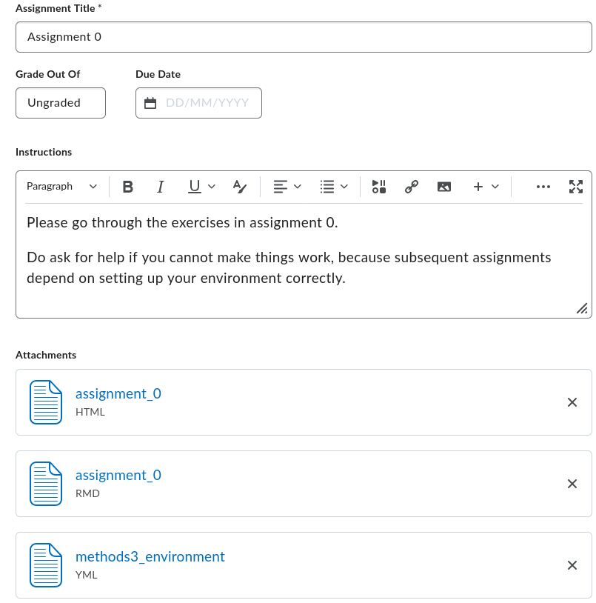
Assignment 0

Slide 9
Let’s get started!

